Slide 1

HTTP Protocol
HTML Forms, HTTP Request & HTTP Response
SoftUni Team
Technical Trainers
Software University
http://softuni.bg

Slide 2
Table of Contents
HTTP Basics – Web Communication explained
HTML Forms – Method & Action
URL
MIME & Media Types
HTTP Request
HTTP Response

Slide 3
Have a Question?
sli.do #csharp-web

Slide 4
http://
HTTP Basics
Web Communication Explained

Slide 5



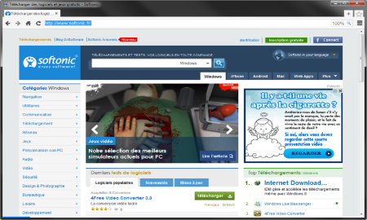





Web Server Work Model
Web Client
Web Server
Technology
Request
Response
Web Resources
Database
HTML, PDF, JPG…

Slide 6

Web Server Work Model
Web Client
Web Server
Technology
Request
.NET Core
Response
Web Resources
Database
HTML, PDF, JPG…

Slide 7


Hyper Text Transfer Protocol
Request
Response
HTTP
HTTP
TCP
TCP
IP
IP
Ethernet
Media (wires / air / fiber)
Ethernet
Notes:
HTTP == Hyper Text Transfer Protocol
Client-server protocol for transferring Web resources (HTML files, images, styles, scripts, data, etc.)
The widespread protocol for Internet communication today
Request-response model (client requests, server answers)
Text-based format (human readable)
Relies on unique resource URLs
Provides resource metadata (e.g. encoding)
Stateless (cookies and Web storages can overcome this)

Slide 8
HTTP Request Methods
Method | Description
POST | Create / store a resource
GET | Read / retrieve a resource
PUT | Update / modify a resource
DELETE | Delete / remove a resource
Other HTTP Methods
CONNECT
HEAD
OPTIONS
TRACE
The four basic functions of persistence storage.
HTTP defines methods to indicate the desired action to be performed on the identified resource

Slide 9
HTTP Conversation: Example
GET /courses/javascript HTTP/1.1
Host: www.softuni.bg
User-Agent: Mozilla/5.0
<CRLF>
HTTP request:
HTTP response:
The empty line denotes the end of the request headers
HTTP/1.1 200 OK
Date: Mon, 5 Jul 2010 13:09:03 GMT
Server: Microsoft-HTTPAPI/2.0
Last-Modified: Mon, 12 Jul 2014 15:33:23 GMT
Content-Length: 54
<CRLF>
<html><title>Hello</title>
Welcome to our site</html>
The empty line denotes the end of the response headers

Slide 10

Dev Tools
Tools for Developers

Slide 11
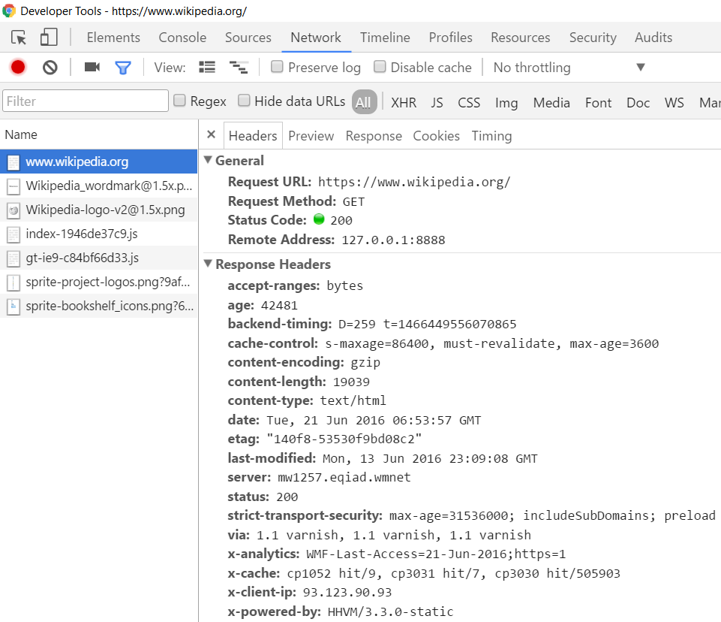
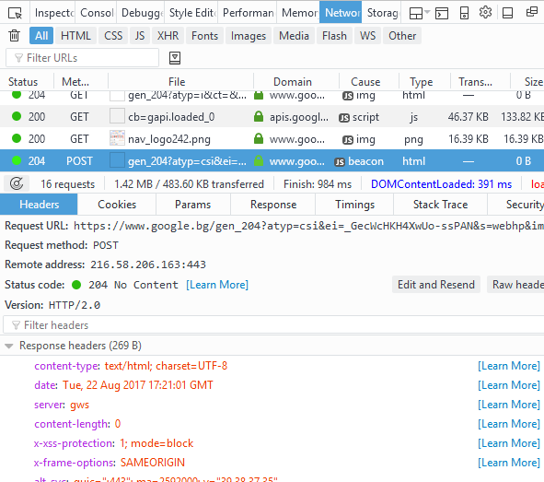
Tools for Developers – Browser Dev Tools
Chrome Developer Tools
Mozilla Developer Tools

Slide 12

Tools for Developers – Browser Add-ons
</>
Postman - Chrome
Rested - Firefox

Slide 13

HTTP Tools for Developers - Desktop
Fiddler
Postman

Slide 14

HTML Forms
Form Method and Action

Slide 15
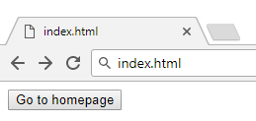

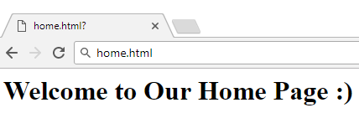

HTML Forms - Action Attribute
Relative URL to the current file
<form action="home.html">
<input type="submit" value="Go to homepage"/>
</form>
Defines where to submit the form data:

Slide 16
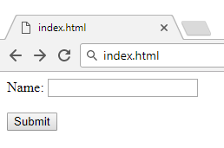

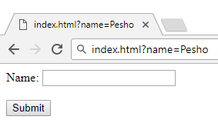

HTML Forms – Method Attribute
Specifies the HTTP method to use when sending form data
<form method="get"> Name: <input type="text" name="name"> <br /><br />
<input type="submit" value="Submit">
</form>
The form data is in the URL

Slide 17
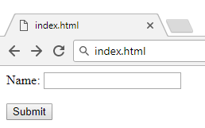

HTML Forms – Method Attribute (2)
<form method="post"> Name: <input type="text" name="name"> <br /><br />
<input type="submit" value="Submit">
</form>
Headers will be explained later
POST http://localhost/index.html HTTP/1.1
Host: localhost
Content-Type: application/x-www-form-urlencoded
Content-Length: 10
name=Pesho
HTTP request body holds the request form data and the response data

Slide 18
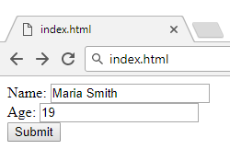
URL Encoded Form Data – Example
<form method="post">
Name: <input type="text" name="name"/> <br/>
Age: <input type="text" name="age"/> <br/>
<input type="submit" />
</form>
POST http://localhost/cgi-bin/index.cgi HTTP/1.1
Host: localhost
Content-Type: application/x-www-form-urlencoded
Content-Length: 23
name=Maria+Smith&age=19
File uploads are not supported

Slide 19

URL
Uniform Resource Locator

Slide 20
Uniform Resource Locator (URL)
http://mysite.com:8080/demo/index.php?id=27&lang=en#lectures
Protocol
Host
Port
Path
Query String
Fragment
URL is a formatted string, consisting of:
Protocol for communicating (http, ftp, https...) – HTTP in most cases
Host or IP address (www.softuni.bg, gmail.com, 127.0.0.1, web)
Port (the default port is 80) – a number in range [0…65535]
Path (/forum, /path/index.php)
Query string (?id=27&lang=en)
Fragment (#lectures) – used on the client to navigate to some section

Slide 21
Query String in C#
Query string contains data that is not part of the path structure
Commonly used in searches and dynamic pages
It is the part of a URL following a question mark (?)
Multiple parameters are separated by some delimiter
http://example.com/path/to/page?name=ferret&color=purple

Slide 22
URL Encoding
URLs are encoded according RFC 1738:
Unreserved URL characters – have no special meaning
Reserved URL characters – can have a special meaning in the URL
Reserved characters are escaped by percent encoding
Space is encoded as "+" or "%20"
[0-9a-zA-Z]
! * ' ( ) ; : @ & = + $ / , ? # [ ]
%[character hex code]

Slide 23
URL Encoding - Examples
All other characters are escaped by %
Char | URL Encoding
space | %20
щ | %D1%89
" | %22
# | %23
$ | %24
% | %25
& | %26
Each character is converted to its ASCII value, represented as hexadecimal digits
Наков-爱-SoftUni
%D0%9D%D0%B0%D0%BA%D0%BE%D0%B2-%E7%88%B1-SoftUni

Slide 24
Valid and Invalid URLs – Examples
Some valid URLs:
Some invalid URLs:
http://www.google.bg/search?sourceid=navclient&ie=UTF-8&rlz=1T4GGLL_enBG369BG369&q=http+get+vs+post
http://bg.wikipedia.org/wiki/%D0%A1%D0%BE%D1%84%D1%82%D1%83%D0%B5%D1%80%D0%BD%D0%B0_%D0%B0%D0%BA%D0%B0%D0%B4%D0%B5%D0%BC%D0%B8%D1%8F
Should be: C%23+.NET+4.0
http://www.google.bg/search?&q=C# .NET 4.0
Should be: %D0%B1 %D0%B8%D1%80%D0%B0
http://www.google.bg/search?&q=бира

Slide 25

MIME and Media Types
Multi-Purpose Internet Mail Extensions

Slide 26
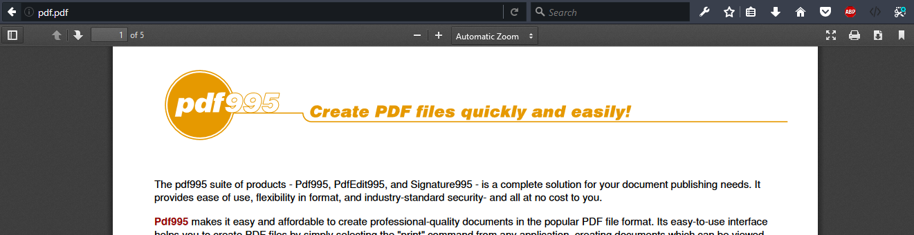
What is MIME?
MIME == Multi-Purpose Internet Mail Extensions
Internet standard for encoding resources
Originally developed for email attachments
Used in many Internet protocols like HTTP and SMTP

Slide 27





Concepts of MIME
Content-Type - media type of the message content
text/html, image/gif, application/pdf
Content-Disposition - specifies the presentation style
attachment; filename=logo.jpg
Multipart messages - multiple resources in a single document

Slide 28
Common MIME Media Types
MIME Type / Subtype | Description
application/json | JSON data
image/png | PNG image
image/gif | GIF image
text/html | HTML
text/plain | Text
text/xml | XML
video/mp4 | MP4 video
application/pdf | PDF document

Slide 29
HTTP Request
What is a HTTP Request?

Slide 30
HTTP Request Message
Request message sent by a client consists of:
HTTP request line
Request method (GET / POST / PUT / DELETE / …)
Resource URI (URL)
Protocol version
HTTP request headers
Additional parameters
HTTP request body – optional data, e.g. posted form fields
<method> <resource> HTTP/<version>
<headers>
(empty line)
<body>

Slide 31
GET Request Method – Example
<form method="get">
Name: <input type="text" name="name" />
Age: <input type="text" name="age" />
<input type="submit" />
</form>
HTTP request line
GET /HTTP/1.1
Host: localhost
<CRLF>
HTTP request headers
The request body is empty

Slide 32
POST Request Method – Example
The POST method transfers data in the HTTP body
POST can send text and binary data e.g. upload files
HTTP request line
POST /login HTTP/1.1
Host: localhost
Content-Length: 59
<CRLF>
username=mente&password=top*secret!
<CRLF>
HTTP request headers
The request body holds the submitted form data

Slide 33

HTTP Response
What is a HTTP Response?

Slide 34
HTTP Response Message
The response message sent by the HTTP server consists of:
HTTP response status line
Protocol version
Status code
Status text
Response headers
Provide meta data about the returned resource
Response body
The content of the HTTP response (data)
HTTP/<version> <status code> <status text>
<headers>
<CRLF>
<response body – the requested resource>

Slide 35
HTTP Response – Example
Example of HTTP response from the Web server:
HTTP response status line
HTTP/1.1 200 OK
Date: Fri, 17 Jul 2010 16:09:18 GMT+2
Server: Apache/2.2.14 (Linux)
Accept-Ranges: bytes
Content-Length: 84
Content-Type: text/html
<CRLF>
<html>
<head><title>Test</title></head>
<body>Test HTML page.</body>
</html>
HTTP response headers
HTTP response body

Slide 36
HTTP Response Codes
HTTP response code classes
1xx: informational (e.g., "100 Continue")
2xx: successful (e.g., "200 OK", "201 Created")
3xx: redirection (e.g., "304 Not Modified", "301 Moved Permanently", "302 Found")
4xx: client error (e.g., "400 Bad Request", "404 Not Found", "401 Unauthorized", "409 Conflict")
5xx: server error (e.g., "500 Internal Server Error", "503 Service Unavailable")

Slide 37
HTTP Response – Example
Example of HTTP response with error result:
HTTP response status line
HTTP/1.1 404 Not Found
Date: Fri, 17 Nov 2014 16:09:18 GMT+2
Server: Apache/2.2.14 (Linux)
Connection: close
Content-Type: text/html
<CRLF>
<HTML><HEAD><TITLE>404 Not Found</TITLE></HEAD>
<BODY>
<H1>Not Found</H1>
The requested URL /img/logo.gif was not found on this server.<P> <HR><ADDRESS>Apache/2.2.14 Server at Port 80</ADDRESS>
</BODY></HTML>
HTTP response headers
The HTTP
response body

Slide 38
Browser Redirection
HTTP GET requesting a moved URL:
The following HTTP response (301 Moved Permanently) tells the browser to request another URL:
GET / HTTP/1.1
Host: http://softuni.org
User-Agent: Gecko/20100115 Firefox/3.6
<CRLF>
HTTP/1.1 301 Moved Permanently
Location: http://softuni.bg
...

Slide 39
Content-Type and Disposition
With Content-Type response header the server specifies how the output should be processed
Examples:
UTF-8 encoded HTML page. Will be shown in the browser.
Content-Type: text/html; charset=utf-8
Content-Type: application/pdf
Content-Disposition: attachment; filename="Report-April-2016.pdf"
This will download a PDF file named Report-April-2016.pdf

Slide 40
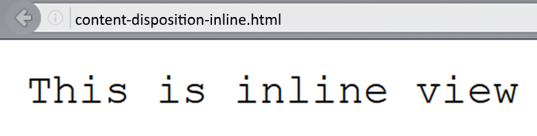
Content-Disposition – Example
Content-Type: text/plain
Content-Length: 19
Content-Disposition: inline filename=example.txt

Slide 41
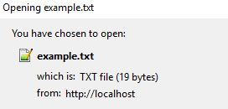
Content-Disposition – Example (3)
Content-Type: text/plain
Content-Length: 19
Content-Disposition: attachment; filename=example.txt

Slide 42

Summary
…
…
…
HTML forms can send 2 types of HTTP requests: GET and POST
HTTP works with message pairs called HTTP request and HTTP response
HTTP headers describe the request / response metadata
See the most used headers here
The URL parts define:
protocol, host, port, path, query string, and fragment

Slide 43
https://softuni.bg/trainings/courses

Slide 44













SoftUni Diamond Partners

Slide 45





SoftUni Organizational Partners

Slide 46




Trainings @ Software University (SoftUni)
Software University – High-Quality Education and Employment Opportunities
softuni.bg
Software University Foundation
http://softuni.foundation/
Software University @ Facebook
facebook.com/SoftwareUniversity
Software University Forums
forum.softuni.bg

Slide 47

License
This course (slides, examples, demos, videos, homework, etc.) is licensed under the "Creative Commons Attribution-NonCommercial-ShareAlike 4.0 International" license

